Slide 1
Digital Portfolio
STUDENT NAME: MOHAMMED ASPAK K
REGISTER NO AND NMID: 2428C0487, 00DE41AF9DDF01F9DF5403361FBAC256
DEPARTMENT: B.Sc. AIML
COLLEGE: KPR COLLEGE OF ARTS SCIENCE AND RESEARCH/ BHARATHIYAR UNIVERSITY

Slide 2
PROJECT TITLE
HEALTHCARE RESEARCH PORTFOLIO

Slide 3


AGENDA
Problem Statement
Project Overview
End Users
Tools and Technologies
Portfolio design and Layout
Features and Functionality
Results and Screenshots
Conclusion
Github Link
3/21/2024 Annual Review

Slide 4

PROBLEM STATEMENT
Many healthcare research portfolios are static and text-heavy.
Traditional resumes do not demonstrate data-driven healthcare insights effectively.
A need for a modern, interactive digital portfolio that highlights both academic background and research contributions in healthcare.

Slide 5

PROJECT OVERVIEW
Designed and developed a personal portfolio website with 3D effects, glassmorphism, and parallax animations.
Portfolio includes: • Personal Information (Name, Department, College, Email) • Research Projects (Healthcare Analytics, Patient Data Insights, Predictive Modeling) • Achievements (Published papers, Data Analysis in Healthcare, EDA on health datasets) • Skills (Python, R, SQL, ML, Healthcare Data Visualization Tools)

Slide 6

WHO ARE THE END USERS?
Healthcare Research Organizations
Hospitals and Medical Institutions
Academic Faculty & Research Guides
Pharmaceutical and Biotech Companies
Data Science Recruiters focusing on Healthcare Analytics

Slide 7

TOOLS AND TECHNIQUES
Languages: Python, R, SQL
Libraries: Pandas, NumPy, SciPy, scikit-learn
Visualization Tools: Tableau, Power BI, Matplotlib
Web Technologies: HTML, CSS, JavaScript (for interactive portfolio)
Specialized Tools: Healthcare datasets, Jupyter Notebooks

Slide 8
POTFOLIO DESIGN AND LAYOUT
Hero Section: Introduction with Name, Department, and Research Focus
About Section: Who I Am, Research Interests, Goals
Skills Section: Healthcare Data Analytics and ML skills
Projects Section: Key Healthcare Research Projects (Predictive Diagnosis, Patient Analytics, Drug Research)
Achievements Section: Publications, Certifications, Conference Presentations
Contact Section: Email and collaboration details
Interactive Features: 3D effects, parallax, floating skill chips
8

Slide 9
FEATURES AND FUNCTIONALITY
3D Hover Effects for research cards
Glassmorphism UI for clean, modern look
Interactive Navigation with smooth scrolling
Research Project Cards with detailed insights
Responsive Layout for mobile and desktop
Contact form for collaboration requests

Slide 10

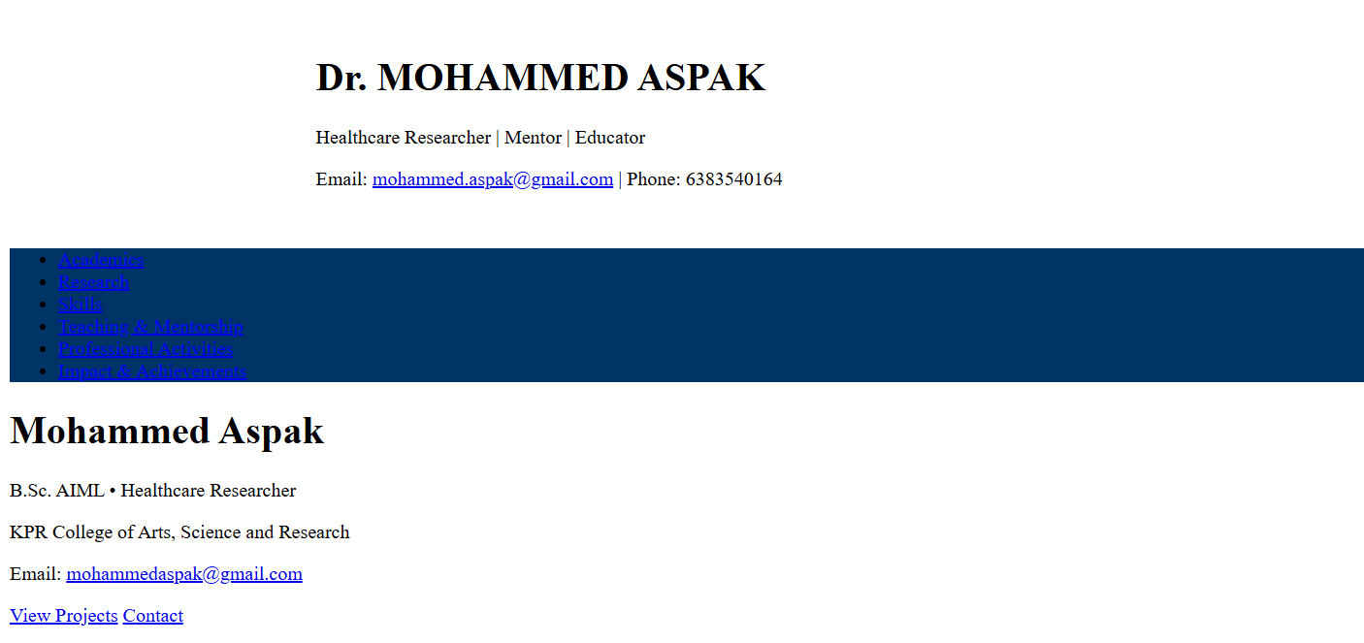
RESULTS AND SCREENSHOTS
Created a professional digital healthcare researcher portfolio
Provides clear visualization of skills and research projects
Engaging 3D and interactive elements
Ready to share with academic institutions, healthcare companies, and recruiters (Insert screenshots of Hero, Research Projects, Skills, and Achievements sections here)
3/21/2024 Annual Review
10

Slide 11
CONCLUSION
Developed a modern Healthcare Researcher Portfolio to showcase skills and research work.
Combines design innovation with research presentation.
Strengthens academic and professional presence in healthcare analytics.
Can be extended with research paper links, dataset access, and collaboration invites.
11

Slide 12
GITHUB LINK
Portfolio Link: https://github.com/MohammedAspak/Port

